Slide 1

InteracTeach
Notes:
Welcome to InteracTeach’s exposition. Here we’ll see how was our work this deliverable.

Slide 2

2
Notes:
This slide is kept for our promotional video, which is located at our main page: www.interacteach.tk

Slide 3

Our Path Today
MVP & Business Idea
Team
Viability
Future Planification
Marketing Plan & Budget
Conclusions
3
Notes:
This is the path we’re going to follow during the presentation. First we’ll talk about our project’s final version, then we’ll see a demo with our business and finally we’ll see our advertising plan.

Slide 4
MVP &
Business Idea
Notes:
First, we’ll start seeing the main features of our idea and our business.

Slide 5




MVP
Transactions
Interactive
Licenses
5
Notes:
In terms of features that our platform offers, our project’s final version offers all the ones we had as our MVP: Our interactive exercises’ system, allowing it to create and save them on our platform, our transactions’ system, allowing to buy and sell interactive exercises and letting programmers get their money from the purchases of the exercises, and the possibility of customizing the licenses related to schools.

Slide 6


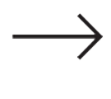

Business Idea
Schools buy licenses
Interactive
Schools buy exercises
6
Notes:
The first way to do so would be selling licenses to schools. These licenses would be active for a year and would allow the schools and academies to make use of the full platform for an entire academic year, renewing it each one to keep the services. Also with the license, schools and academies would have access to an amount of starting exercises that can be increased by buying more exercises.
The second way we have for having a profit with these project is selling exercises. Interactive exercises have a buying price, which is payed for the schools and academies in order to increase the amount of exercises they have access to.

Slide 7
Business Idea: Licenses
SIZE | USERS | FREE EXERCISES | PRICE
BASIC | 60 | 20 | 200€/y
MEDIUM | 200 | 50 | 550€/y
LARGE | 500 | 75 | 700€/y
7
Notes:
Then, we can order the different kinds of licenses we offer by the amount of users allowed to register and the number of starting exercises the client could access at first. That would lead us to these standard sizes of licenses, with their associated price. Also, in case of not finding a suitable size for him/her, the client can always contact us in order to negotiate a suitable size and price of license for both of us.

Slide 8


Business Idea: Exercises
25%
75%
Programmer gets money
8
Notes:
For the purchase of interactive exercises, each one will be worth € 4 for the school. A 75 percentage goes to the programmer, acting as a motivation for possible content creators for the platform, and a 25 percentage is kept for us.

Slide 9

Business Idea: Demo
www.interacteach.tk
9
Notes:
To show how the system works today and how can we get money with it, we’ve put a link in which everyone can see our project, and also we’ve created a demo, showing our two main money sources: Licenses and interactive exercises’ purchase.
Demo (Investor): https://www.youtube.com/watch?v=SO9AnBQ2fhg
Demo (Programmer): https://www.youtube.com/watch?v=6k1peOpi0hI&feature=youtu.be
Paypal’s credentials for a school: schoolCC@hotmail.com / climbcodeISPP2018
Admin Account: administrador / climbcode

Slide 10

Team
Notes:
You’ve seen our product. Now, the team behind it.

Slide 11
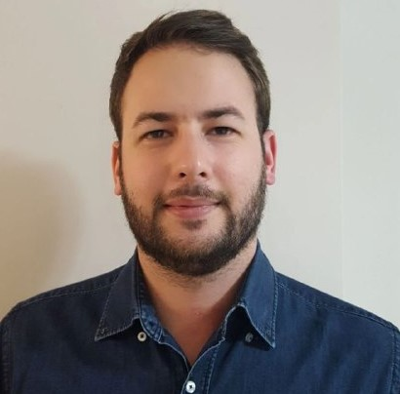

Team (I)
MEMBER | ROLE | CORE SKILLS
 | Project Manager | Team management Scrum Requirements analysis
 | Business Manager | Marketing Scrum Requirements analysis
Alejandro Román Rodríguez
Álvaro Domínguez Núñez
11
Notes:
Alejandro Román Rodríguez is our Project Manager. He has previous experience in team management and Scrum. He also has knowledge about requirement analysis, which is essential for the project.
Álvaro Domínguez Núñez is the Bussines Manager. He’s the designer of the piloting plan, due to his marketing knowledge.

Slide 12
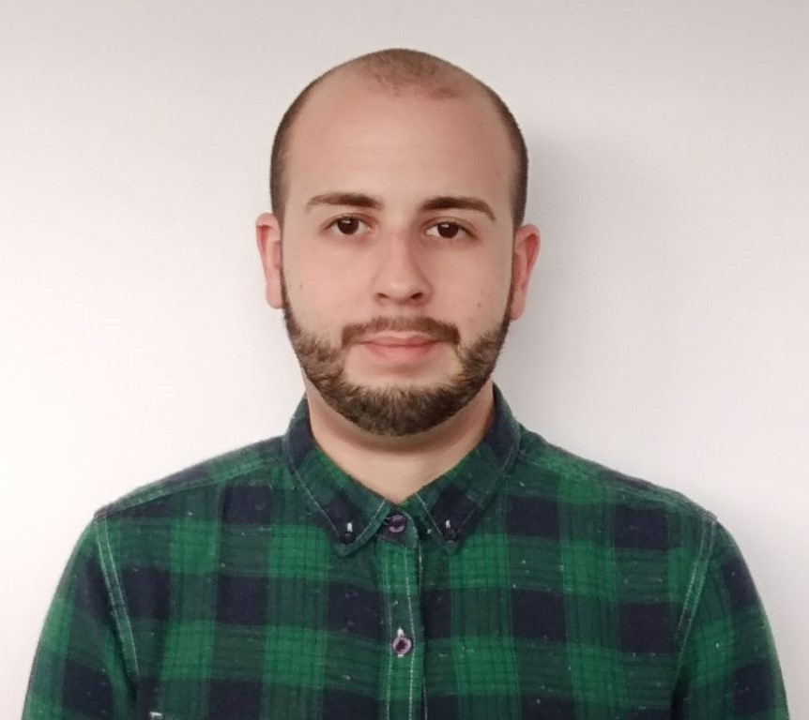
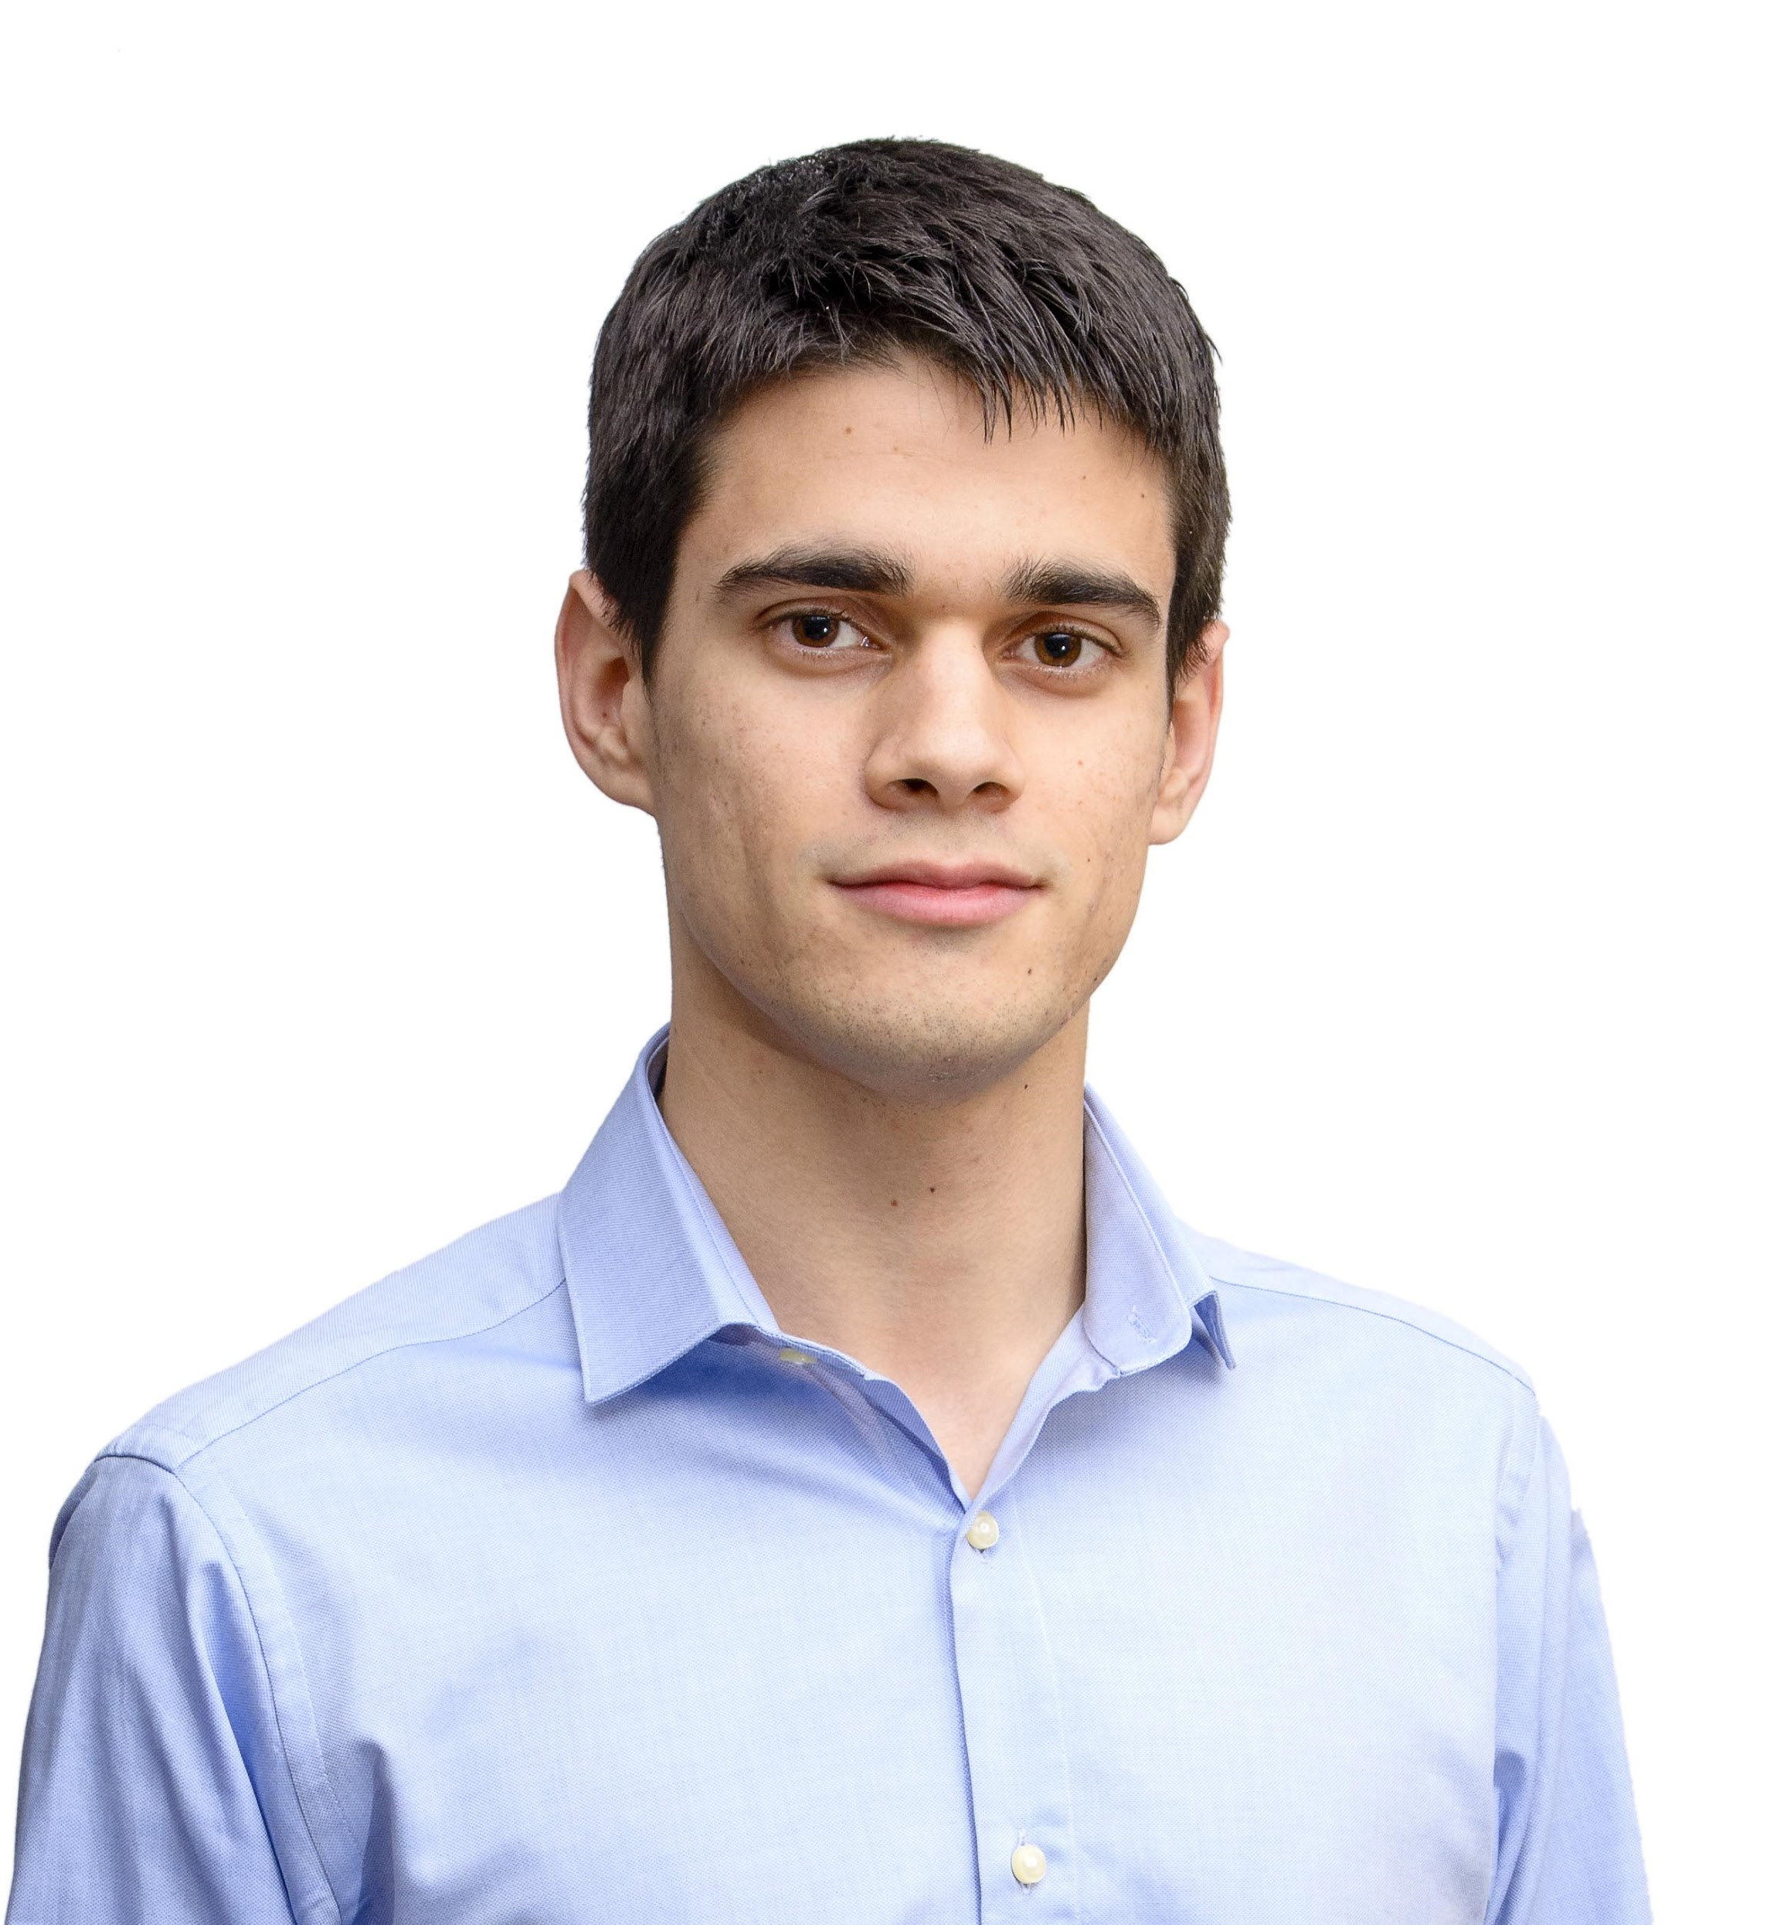
Team (II)
MEMBER | ROLE | CORE SKILLS
 | Front-End Developer | JavaScript Ajax Bootstrap
 | Front-End Developer | Bootstrap Web Design JavaScript
Miguel A. Baños Carretón
Alejandro Garrido Resina
12
Notes:
Miguel Ángel Baños Carretón is one of our Front-End Developers. He has skills in JavaScript and Ajax and he’s one of the designers of the interactive exercises’ system.
Alejandro Garrido Resina is another of the Front-End Developers. He has previous experience in web design and he has knowledge about Bootstrap and JavaScript.

Slide 13
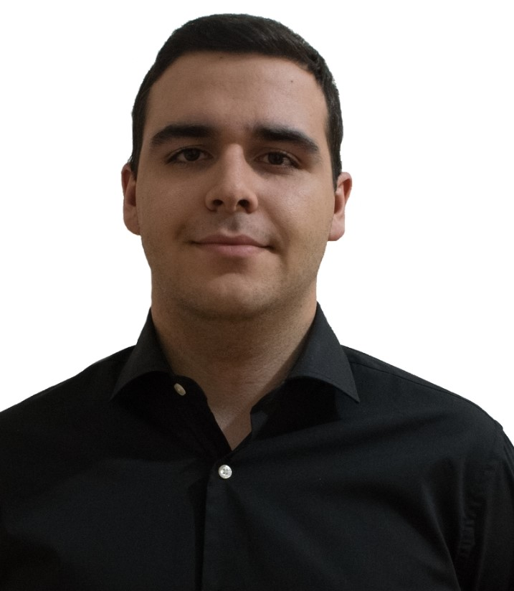
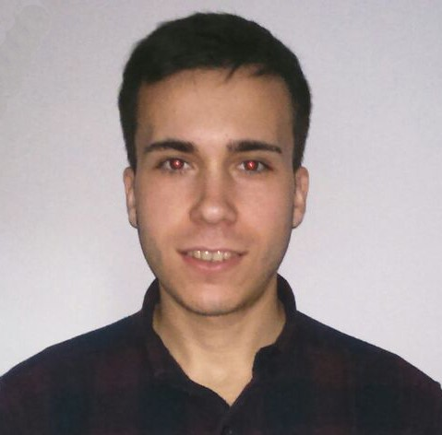
Team (III)
MEMBER | ROLE | CORE SKILLS
 | Back-End Developer | Deployment Tools Django MySQL
 | Back-End Developer | Django DB Design MySQL
Andrés Fernández Alés
Álvaro Sánchez López
13
Notes:
Andrés Fernández Alés is one of our Back-End Developers. He’s responsible for the deployment of the application and he has knowledge of Django and MySQL.
Álvaro Sánchez López is another of our Back-End Developers. He is the database designer and he has previous experience in Django Framework.

Slide 14
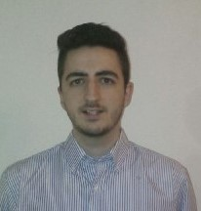
Team
MEMBER | ROLE | CORE SKILLS
 | Back-End Developer | Deployment Tools Django MySQL
Jesús Sosa Sánchez
14
Notes:
Finally we have Jesús Sosa Sánchez, Back-End Developer. He has knowledge in deployment tools and Django Framework.

Slide 15
Viability
Notes:
Now that we know the whole idea behind InteracTeach, let’s talk about its viability.

Slide 16





Competitors & Us
PRODUCT | INT. EXERCISES | EXPLANATION OF EXERCISES | ADAPTED TO EDU. CENTRES | MULTIPLE DISCIPLINES
thatquiz.org
16
Notes:
In order to know how viable our project is, we’ve studied many competitors. In this table we can see the main ones. As we see, too, not all of them have interactive exercises to help teaching, and almost none of them explains their exercises, in case that they have. Also, we’re one of the few education-oriented platform, because our competitors, even if they do it too, are more focused on academical management instead of teaching.

Slide 17

Differential fact
+
Explanation
Interactive
17
Notes:
So, as a clarification, what makes us different from the other products and platforms is that we have a new way to help teaching, doing it through our interactive exercises, and not only by using them, but explaining them step by step too, which helps students to learn better and quicker.

Slide 18







SWOT
STRENGTHS
WEAKNESSES
OPPORTUNITIES
THREATS
SCALABLE
18
Notes:
Also our viability is seen in this SWOT matrix. There, we can see our project’s strengths, which are the big difference between us and our competitors as we’ve seen in previous slides, and how easy is the platform to use.
About or weaknesses, we find that it would be hard to expand to other markets, because our product is too focused on the educational sector. Also, teachers aren’t able to correct their exercises, which could make our users fall slightly.
Speaking about the opportunities, we have that it would be possible to jump to another platform different from the computers, for example tablets, which would increase the amount of clients we could get regarding the extension of the usage of tablets in teachers. The other opportunity is that it is also possible to add new features to our product, which would make us fulfill more of our client’s needs.
And last, the threats that our project has to face are two: The fact that our competitors could take our idea and use it on their products, making competence harder for us.

Slide 19
Future Planification
Notes:
Now it’s time to talk about our short-, mid- and long-term goals. That is where we imagine InteracTeach can be in the future.

Slide 20



Short - term goals (1-2 years)
Advertising
+40 schools
+50 program.
Public Admin.
negotiation
20
Notes:
In the short-term (1-2 years), our objective is reach at least +40 schools (schools and academies) and + 50 programmers who create the interactive exercises in our platform. On the other hand, we want to expand InteracTeach by the public sector but it’s difficult since the administration public controls over the budget of the schools, for this we foresee constant negotiations while the platform’s growing and until public administration sees our potential and benefits we’ve got in the private sector. Finally, we want to increase our advertising plan in order to reach more potential clients.

Slide 21



Mid- term goals (3-6 years)
Public sector
Users x2-3
Meetings
21
Notes:
In the mid-term (3-6 years ahead), we want to have an agreement with the public administration and that the platform be used in the public centres. That would facilitate our second objective: doubling the number of users who use our platform. Finally, we also want to expand out or business giving some talks or conferences.

Slide 22



Long-term goals (+ 7 years)
Expansion
Open offices
Hire new people
22
Notes:
And what about long-term? That can sound ambitious but we trust in the chain effect so we expected to expand our business nationally and internationally, hire new people to expand and support our system and open some offices for working.

Slide 23
Marketing Plan & Budget
Notes:
Now we’ll talk about our marketing plan.

Slide 24
Marketing Plan: Focus
SCHOOLS
PROGRAMMERS
24
Notes:
Our platform is focused in two main groups of users: The first is formed by independent programmers (professional or not) between 18 and 35 years from Spain, with superior studies and interested in software, engineering and development.
The other one is educational centres, formed by an adult public from spain between 30 and 65 years, with superior studies and interested in education, teaching or academies.

Slide 25
Advertising Plan: Budget
Budgeted: €4150
Invested: €4310
25
Notes:
To successfully reach both groups, we budgeted at the beginning of the project a total of €4150 in matters of advertising. From that amount, we’ve spent a total of €4310, €160 than expected.

Slide 26
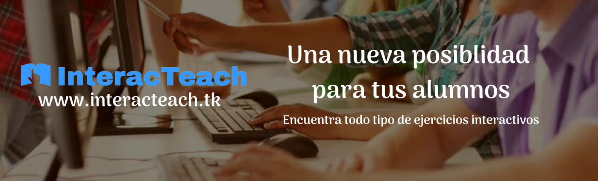
Mark. Plan: Banners (Teachers)
26
Notes:
.A first approach in order to do these advertising plan is the creation of advertising banners. As we see, we’ve created one for teachers…

Slide 27
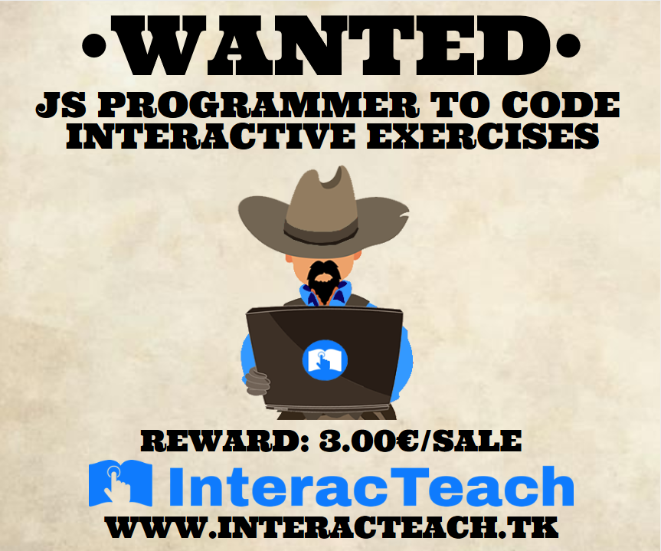
Mark. Plan: Banners (Programmers)
27
Notes:
Another one for programmers, in which we show how can they benefit from collaborating with us…

Slide 28

Marketing Plan: Banners (Investors)
Banners: €114
28
Notes:
And one last for investors. The banners we’ve used are these ones, and we’ve spent a total of €57 in their creation.
Banners:
https://image.ibb.co/kr02y8/Interac_Teach_Inversor.jpg
https://image.ibb.co/idH4BT/Interac_Teach_escuela.jpg
https://image.ibb.co/hDeyMT/Interac_Teach_programador_2_3.jpg

Slide 29


Marketing Plan: Social Networks
@interacteach
€473
@interacteach
€3000
29
Notes:
We’ve also decided to start advertising ourselves in social networks. In order to do so we’ve created and managed our accounts in Twitter (@interacteach) and Facebook (@interacteach), and spent €3473 in the placement and maintenance of our advertising campaign with our banners.
We decided to invest more money in facebook because we know that we can reach a higher amount of programmers and teachers there.

Slide 30
Marketing Plan: Meetings
Marketing Meetings: €160
30
Notes:
The third approach was the realization of advertising meetings with schools, showing them our project and trying to get as many new users as possible. We’ve spent a total of €160 in this area.

Slide 31

Marketing Plan: Promo
Promo: €560
31
Notes:
And finally, we’ve created a promo which is placed in our main website, as an advertise and a way to get more users. We’ve spent on it a total of €560. The video is located in our main page: https://www.interacteach.tk/

Slide 32



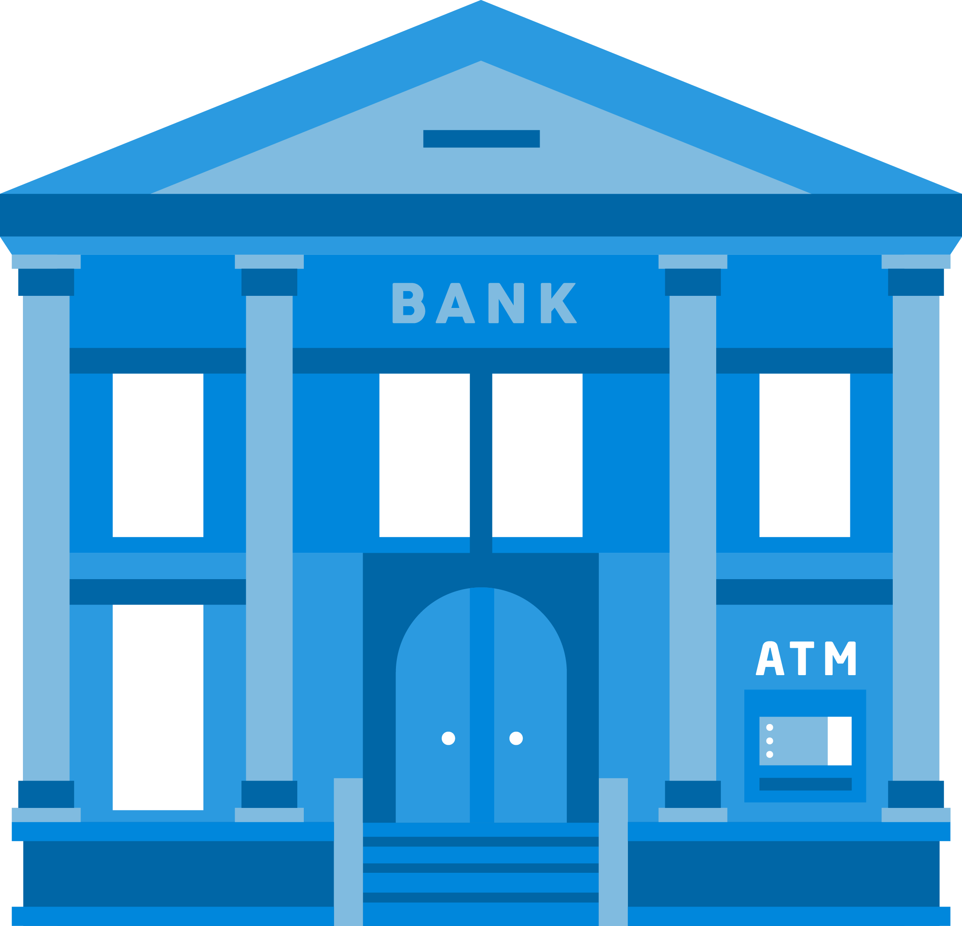


Budget: Posible financing
Family, Friends & Fools
Banks
32
Own
Notes:
In order to achieve the completion of our project, we need to start looking for money. We have a few possibilities: such as the 3Fs (Family, Friends and Fools), financing with loans from banks, or using our own money and effort to advance in our project.

Slide 33



Budget: Bank financing
Monedo
-
€5.000
Caixa
-
€9.600
Sabadell
-
€100.000
33
Notes:
We have checked the possibility of using a loan to get money. These are three options we have found:
Monedo: A 5000€ loan, it wouldn’t cover all of our expenses but it would get us going. The problem is that the final cost would be almost double of the money we get : 9520€.
Caixa: A 9.600€ loan, which would cover our expenses and the return would be in 48 months (14.000€)
Sabadell BStartup10: 100.000€. That is indeed a great sum of money, way over our expenses. It also come with a backing from Sabadell, a help to develop the project. Unfortunately, the requirements are high and they only invest in 10 startups every year. (Para optar hay que estar constituido como empresa, una participación social del capital…)

Slide 34
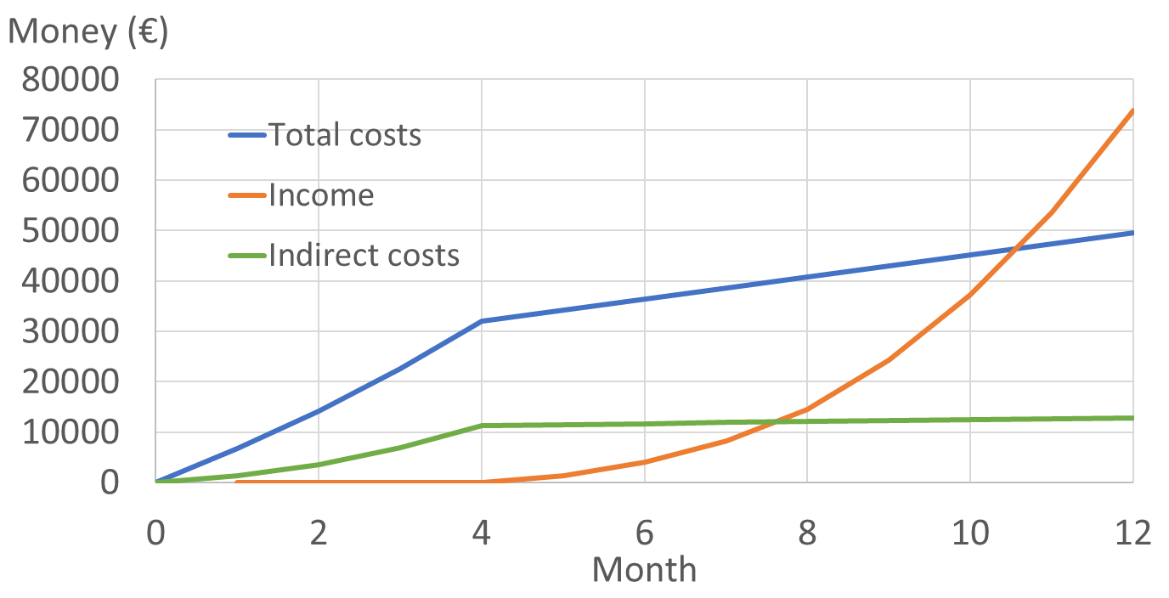
Budget: Estimate
34
Notes:
As we see here, accounting with the expenses, including the costs of our workers, considering an increase of licenses bought, with the consequent exercise exchange, we would reach the breaking point around month 11. If we don’t consider the costs of our work, we get it much sooner, around month 8.
Considering this, and the gross of our expenses (hosting, marketing…) can be paid monthly, we have considered on relying on our own budget. Should we new an extra influx of funds, we would make use of the Caixa’s loan to keep going,as it provides a reasonable amount of money with nice conditions.

Slide 35
Conclusions
Notes:
Finally, we’d like to show some conclusions about our whole project

Slide 36

Conclusions
36
Notes:
At this point, the team is very involved into the project, and also is implicated in working without any remuneration until the project reaches its breaking point. We’ve spent a lot in the development of this work. We’ve put all the meat we had on the spit and we’re very proud of what we’ve done, but there’s still work to be done to achieve the success we’re hardly looking for.

Slide 37

THANKS!
You can find me at
alvdomnun@alum.us.es
37
Notes:
And that’s the end of our presentation! Thank you for watching, and if you have any doubt you can contact me at alvdomnun@alum.us.es.

